Slide 1


Maze Runner Game
BIT II Semester
Bipin Tamang [322640]
Dikshant Khanal [322642]
Soviet Khaling Rai [322667]

Slide 2
Contents / Agenda
Introduction
Problem Statements
Motivation
Features
Objectives
Algorithm
Flowchart
Platform (Development Environment)
Gantt Chart
Conclusion

Slide 3
Introduction
Maze Runner is a console-based game where the player navigates through a maze to reach the goal while avoiding obstacles.
To move the player from the starting point to the endpoint in the shortest path without hitting walls or traps.

Slide 4
Problem Statements
Console based game
Collision and Boundary Management
User Input and Movement Handling
Maze Navigation Logic

Slide 5
Motivation
Developing Logical Thinking
Foundation for Game Development
To Strengthen Problem-Solving Skills
Building a Portfolio Project

Slide 6
Features
Player Movement with Keyboard Input
Maze Generation and Display
Start and End Point in Maze
Collision Detection
Win Condition Check
Customizable Maze Size
Game Restart

Slide 7
Objectives
To design collision detection and scoring system
To design and implement a function maze game design

Slide 8
Algorithm
Step 1: Start the program.
Step 2: Display the main menu with options: Start Game, High Scores, and Exit.
Step 3: Read user's menu choice.
Step 4: If Start Game is selected:
• Display difficulty menu (Easy, Medium, Hard).
• Configure game settings based on selected difficulty.
Step 5: Generate a random maze according to the chosen difficulty.
Step 6: Initialize player position, lives, score, and timer.
Step 7: Start the game loop while player has lives, has not quit, and exit is not reached:
• Display maze, player position, lives, time, and score.
• Read player movement input (W, A, S, D)
•If player hits a wall, reduce one life.
•If player presses X, quit the game.
•Update steps and score.
Step 8: If player reaches the exit, declare Victory.
Step 9: If lives become zero or player quits, declare Game Over.
Step 10: If victory is achieved, take player name and save score to the high score file.
Step 11: Ask the player whether to play again.
Step 12: If Yes, generate a new maze and restart the game.
Step 13: If No, return to the main menu.
Step 14: If High Scores is selected from the menu, display stored scores and return to the menu.
Step 15 : If Exit is selected, terminate the program.
Step 16 : End.

Slide 9
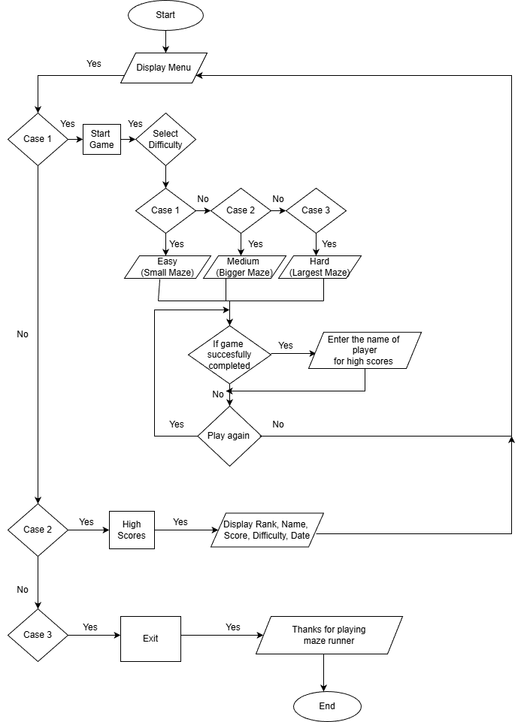
Flowchart

Slide 10
Platform (Development Environment)
Programming Language: C++
Database: File Handling
Development Tools: Dev C++
Compiler: GCC(GNU Compiler Collection)
Operating System: Windows 11/ MacOS

Slide 11
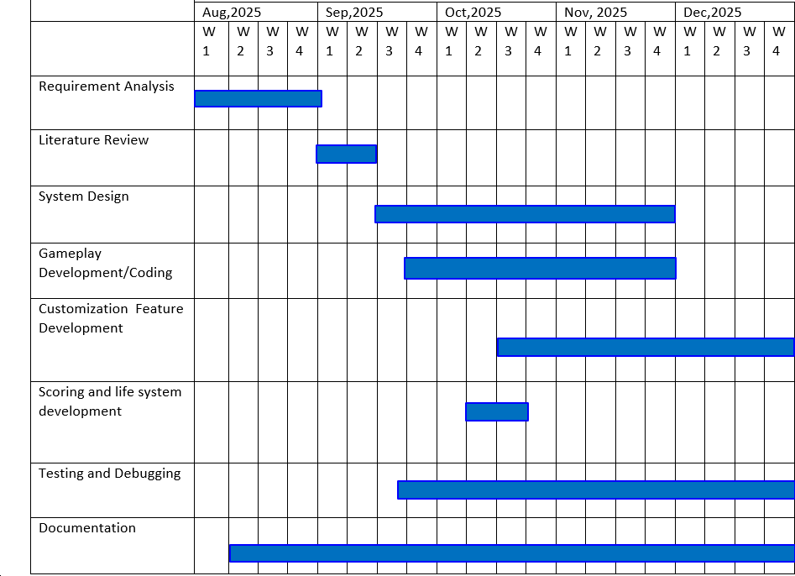
Gantt Chart

Slide 12
Conclusion
Core game features like maze generation, player movement, and collision detection were effectively implemented.
Player movement and control were smooth and user-friendly.

Slide 13
Questions/Queries

